Slide 1
Category review: Chips
July 2022
Retail Analytics
Brand note: If client logo is not required, use alternate title page layout right click slide thumbnail > Layout > Title

Slide 2
Notes:
To view Privacy video explaining how important data privacy is to Quantium, please click here: https://www.youtube.com/watch?v=Zq1QDAkoRzU
or here Q:\Company Reference\Brand & Design\Brand videos\Q Privacy.mp4
At Quantium, we believe that data is the behavioural footprint of humanity and that it has to be treated with the utmost care and responsibility.
Histories, attitudes, indeed lives are stored within it in ways that aren’t always apparent – and that’s what makes its potential so powerful.
To work with it responsibly, sensitively, we set ourselves the highest data privacy protection and governance standards.
We have spent 17 years perfecting privacy-by-design and secure-by-design principles. Central to this is not holding any personally identifiable information about people –
we neither receive it, and put the necessary protections in place to be unable to decipher it.
Every aspect of handling data is safeguarded: from its de-identification, to its encryption – data security is paramount and of the highest grade.
We pride ourselves on gaining the trust of iconic organisations around the world through years of securely working with their data,
and in turn the trust that builds with their stakeholders.

Slide 3
Executive summary
01
Task 1
The mainstream young singles/couples and retirees is due to there being more of them than other buyers. Mainstream, midge and young singles and couples are also more likely to pay more per packet of chips.
This is indicative of impulse buying behavior. We’ve also found that Mainstream young singles and couples are 23% more likely to purchase Tyrrell chips compared to the rest of the population.
02
Task 2
Trial stores 77 and 88 during the trial period show a significant difference in at least two of the three trial months but this is not the case for trial store 86. We can check with the client if the implementation of the trial was different in trial store 86 but overall, the trial shows a significant increase in sales.

Slide 4
01
Category

Slide 5
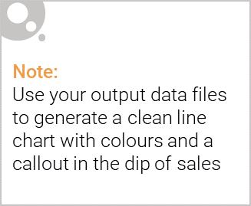
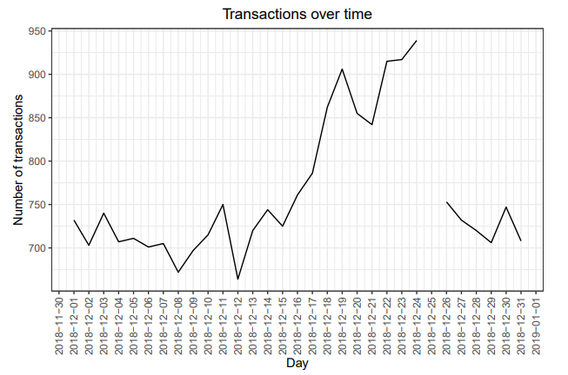
The increase in sales occurs in the lead-up to Christmas and that there are zero sales on Christmas day itself. This is due to shops being closed on Christmas day.

Slide 6

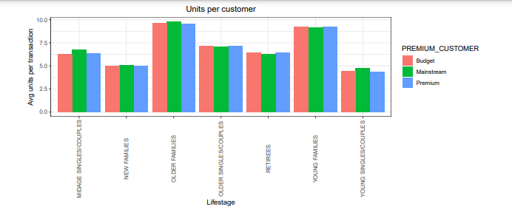
Sales increase steadily as the Christmas day approaches and return again to early December sales level during New Year Eve.
Sales mainly came from Budget - older families, Mainstream - young singles/couples, and Mainstream - retirees. In total contributing 25% of sales revenue.

Slide 7
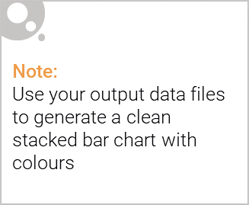
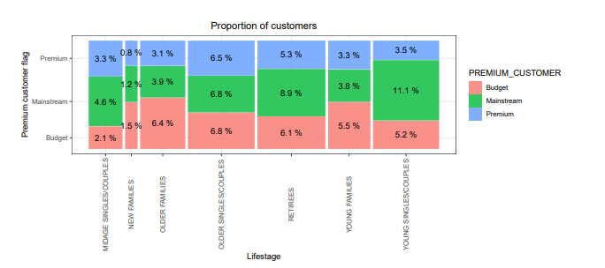
Editable (delete this)
Older and Young Family segment have the highest average purchase units per unique customer
Sales mainly came from Budget - older families, Mainstream - young singles/couples, and Mainstream - retirees. In total, older customers buy more than younger customers. Non-premium customers buy more than premium customers.

Slide 8
02
Trial store performance

Slide 9
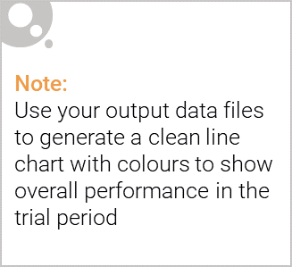
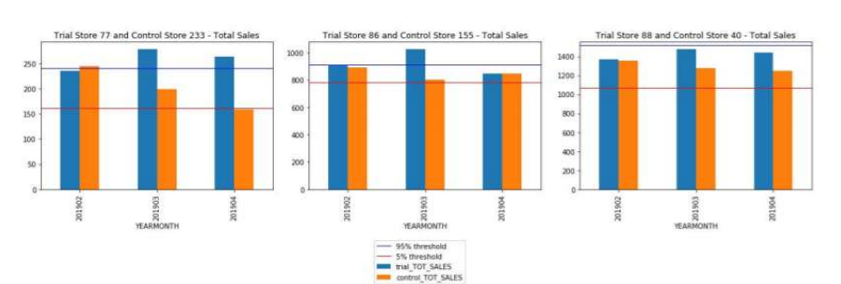
We can see that Trial store 77 sales for Feb, March, and April exceeds 95% threshold of control store. Same goes to store 86 sales for all 3 trial months.
Whereas trial store 88 sales increase is insignificant.

Slide 10
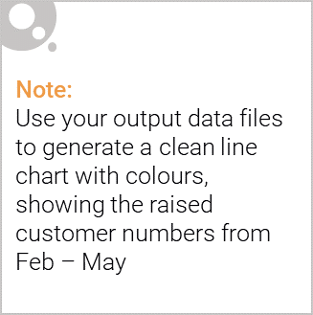
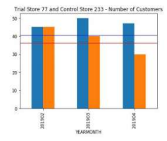
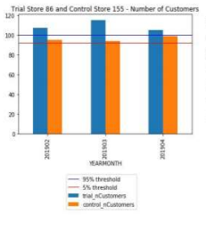
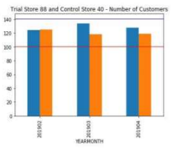
Trial store 77: Control store 233
Trial store 86: Control store 155
Trial store 88: Control store 40
Both trial store 77 and 86 showed significant increase in Total Sales and Number of Customers during trial period. But not for trial store 88. Perhaps the client knows if there's anything about trial 88 that differs it from the other two trial.
Overall the trial showed positive significant result.

Slide 11
Thank you!
ANY QUESTIONS?

